Slide 1
July 2016
Data Integration and Migration automated Testing

Slide 2



BUSINESS PAINS / PROBLEM AREAS
PERSON A
Integration Testing Team
Validating huge volumes of data available in upstream systems which flows into various target systems via Migration/Integration process
Expediting the Entry , Extraction, Validation of Data between integrated systems in CHUBB.
PROBLEM STATEMENT :
SOLUTION - DATA MIGRATION AUTOMATION :
How might we extract data from source system and cross validate the field translations to Destination System faster?
Source System : Subscribe
Automated data creation & extraction
Data Segregation from the Migrated Data feeds for Validation
Automated Macro Utility
WorkView Application Verification
Automated Test Suite using Selenium

Slide 3
BENEFITS & SAVINGS
Data Migration Automation has been implemented for CGM.
92 PD
$21 K
Swift Comparison of data transition between Integrated Systems.
No Human Errors.
Additional coverage.
Effort Savings
Cost Savings
FUTURE SCOPE:
Can be customized and leveraged for other Integration & Migration Project
CHUBB Migration Projects
WorkView Release 2 - COG - ASPAC, EMEA, LATAM
3

Slide 4
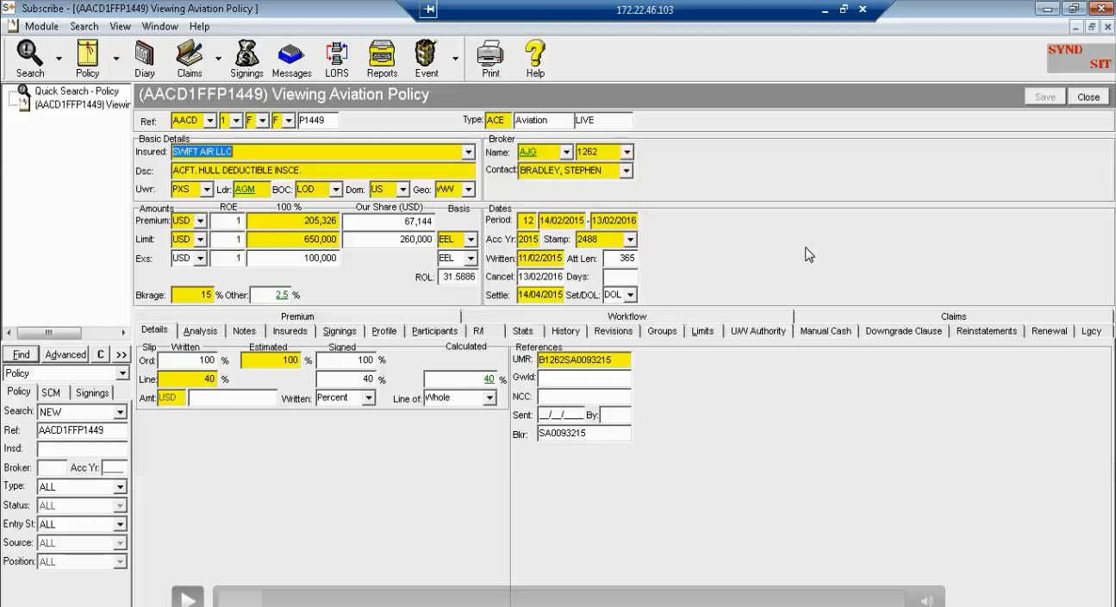
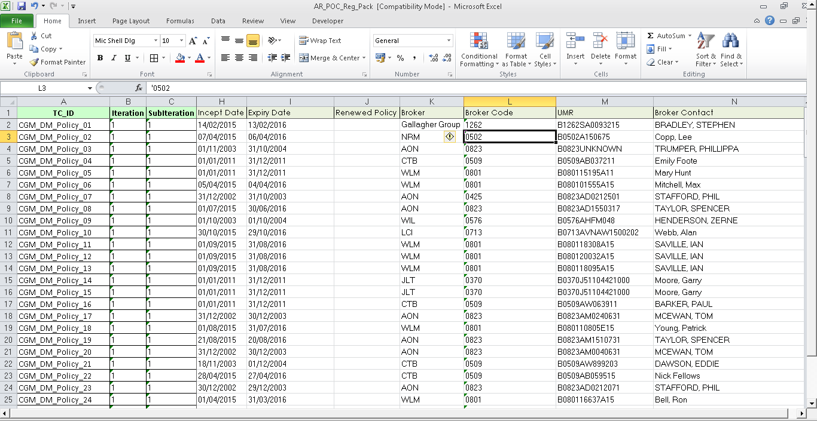
Extracting policy values from SUBSCRIBE
Extracted policy values in EXCEL

Slide 5
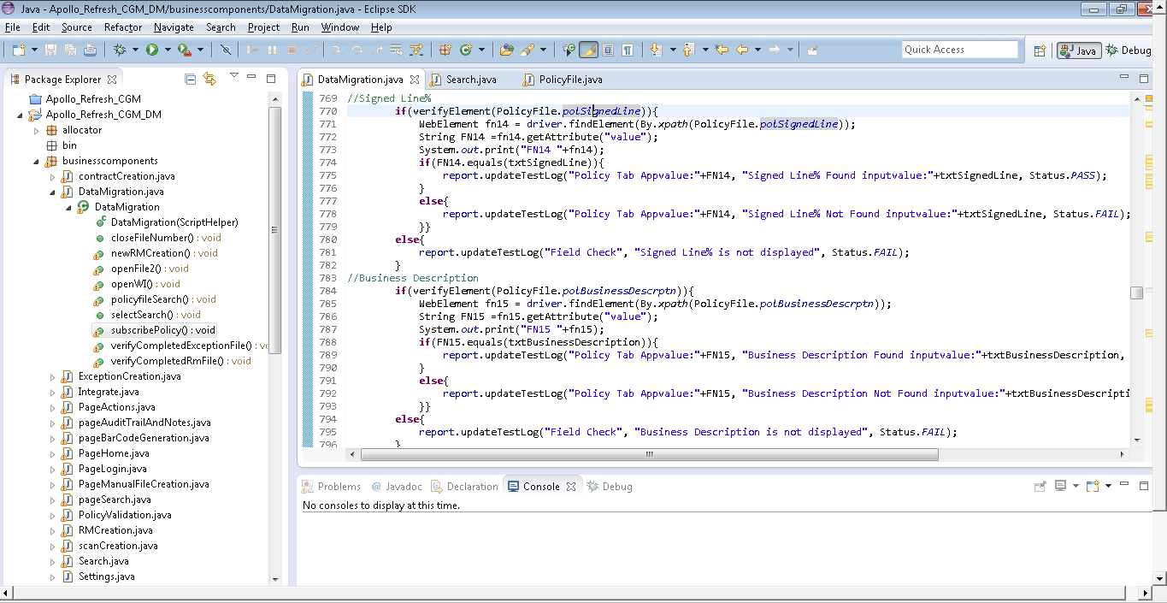
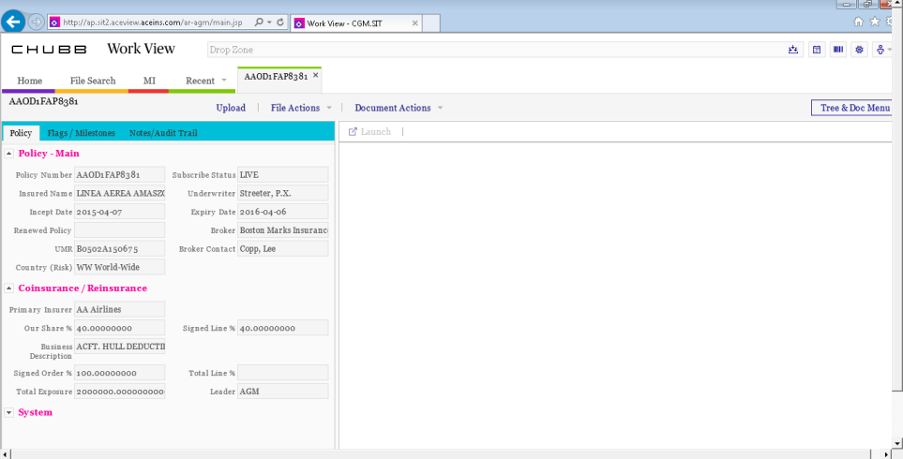
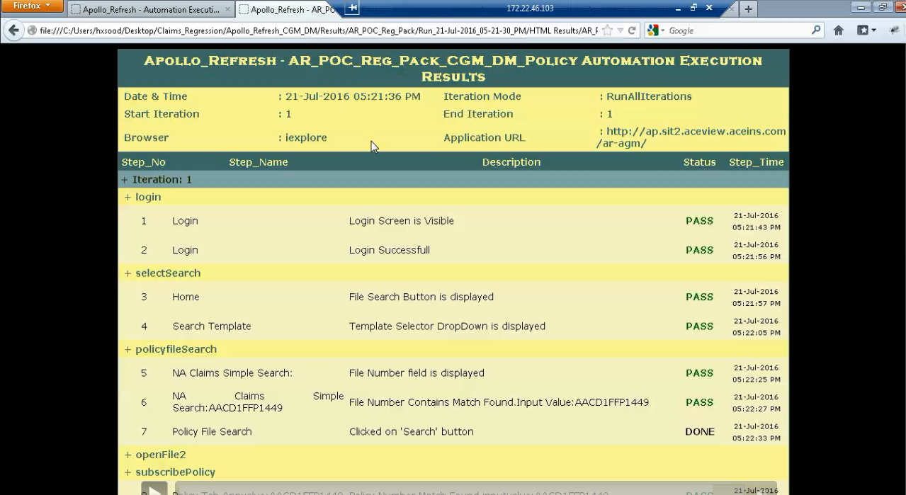
SELENIUM script
WORKVIEW validation
HTML validation results

